Slide 1
EduLang
by: Issa Ayman Sarhan

Slide 2
CONTENTS
01
Why edulang
02
Gathering Requirements
03
Who is it for?
04
Can we implement it?
05
Future plans

Slide 3
What is EduLang?
how did the idea come from

Slide 4
Why should you use EduLang
what can it accomplish?

Slide 5
Gathering Requirements
Teachers
Students
Developers
Existing Similar Games

Slide 6
Who is For?
100%
Elementary School
50%
Primary School
25%
Secondary School
5%
University Level

Slide 7
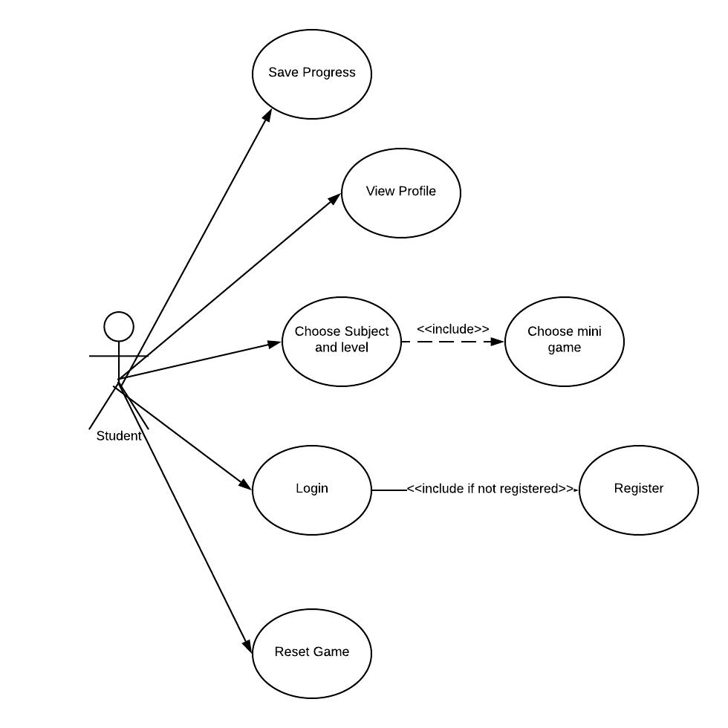
Usecase Diagram

Slide 8
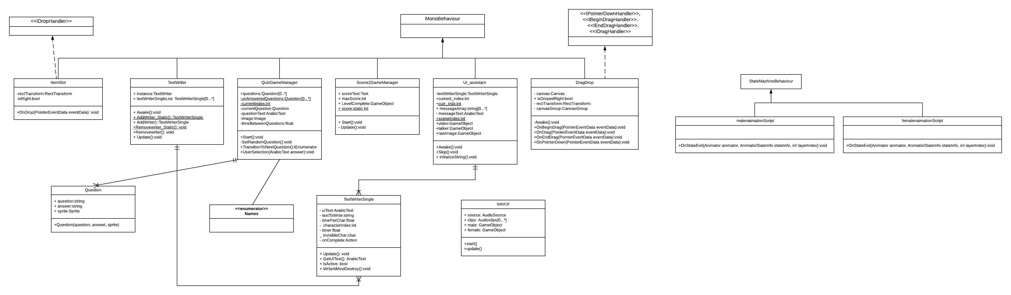
Class Diagram

Slide 9
Can we implement it?
Demo

Slide 10
Future Plan?
Try and complete the game
Gather a larger team with more professionals
Find ways to constantly upgrade it

Slide 11

THANK YOU

